Slide 1
PROJECT OVERVIEW

Slide 2
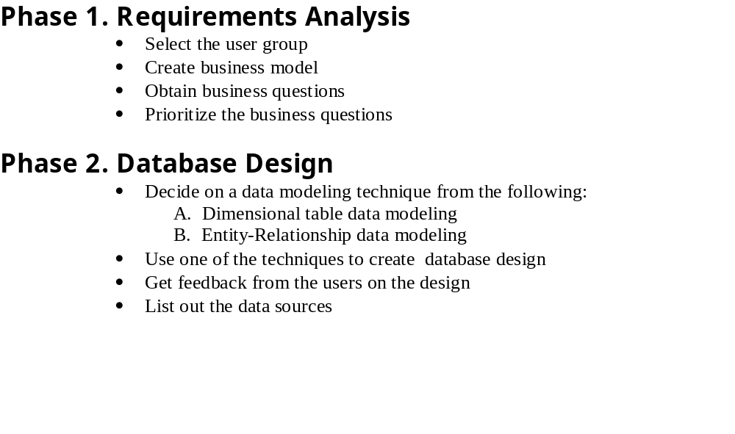
Project’s Data Warehousing Design Process
Report 1
Report 2

Slide 3
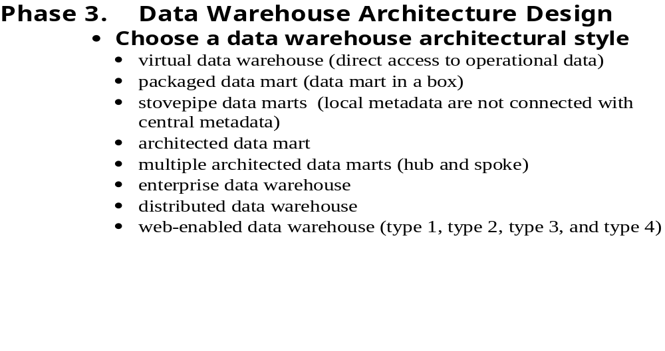
Project’s Data Warehousing Design Process
Report 1
Report 2

Slide 4
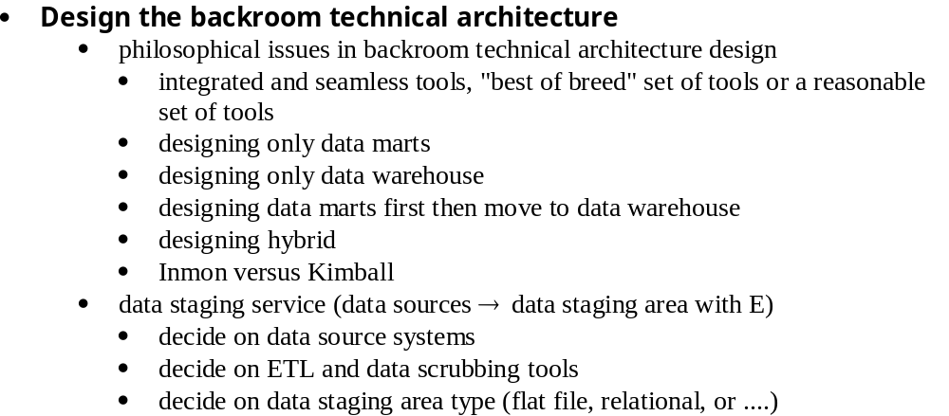
Project’s Data Warehousing Design Process
Report 3

Slide 5
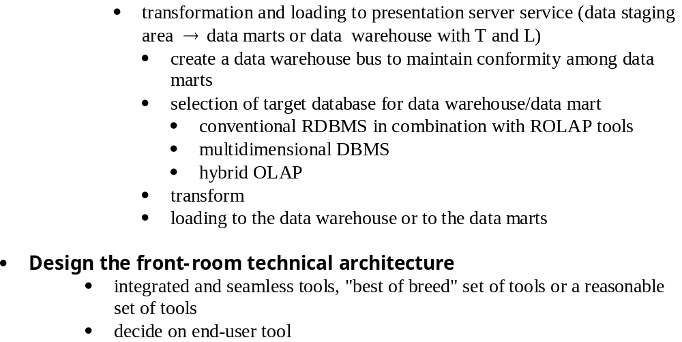
Project’s Data Warehousing Design Process
Report 3
Report 4

Slide 6
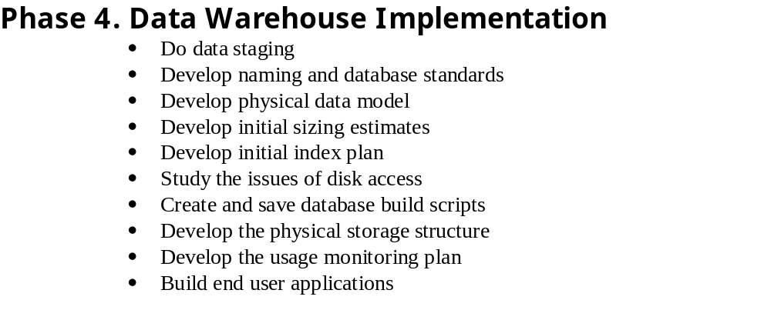
Project’s Data Warehousing Design Process

